Slide 1

Electricity Demand and Price Forecasting
An Infosys Springboard Internship Project
By: Deep Kshirsagar
Date: 19 July 2024

Slide 2
Problem Statement
Objective:
Develop machine learning models to forecast electricity demand and prices.
Importance:
Enables efficient energy management and operational planning.
Assists utility companies and grid operators in optimizing energy generation, distribution, and consumption.
Goals:
Accurately predict future electricity demand based on historical data.
Estimate future electricity prices using past trends and influencing factors such as weather conditions and energy generation data.
Enhance decision-making and resource management in the energy sector.

Slide 3
Content
Data Introduction
Exploratory Data Analysis (EDA)
Feature Engineering
Data Visualization
Model Implementation
Model Comparison
Model Selection
Conclusion

Slide 4
Energy Dataset
Contains historical data on:
Energy generation from various sources
Forecasts for solar and wind generation
Actual load data
Actual price data
Importance:
Developing models to predict future electricity demand and prices
Enabling better resource management
Enhancing operational planning
Weather Features Dataset
Provides comprehensive weather data
Key attributes:
Temperature
Humidity
Wind speed
Weather conditions
Importance:
Understanding the impact of weather conditions on electricity demand and generation
Crucial for modeling energy consumption patterns
Data Shape: (35064, 29)
Data Shape: (178396, 17)
Granularity: Hourly
Granularity: Hourly
Data Introduction

Slide 5


Exploratory Data Analysis (EDA)
Data Preparation
We have to aggregate the ‘weather_data’ at city level.
Converted categorical columns to strings.
Aggregation of Weather Data
Defined a function to get the most frequent value for categorical features.
Grouped weather data by 'dt_iso' and aggregated using mean for numerical columns and mode for categorical columns.
Aggregated Weather Data Sample
Sample of the first 5 rows showing average values for temperature, pressure, humidity, wind speed, etc.
Merge ‘energy_data’ and ‘weather_aggregated_data’ datasets as a Left Join based on 'time' columns
dropped the columns which having the sum zero or null values
Imputing the missing Values Using Forward Fill and Backward Fill

Slide 6
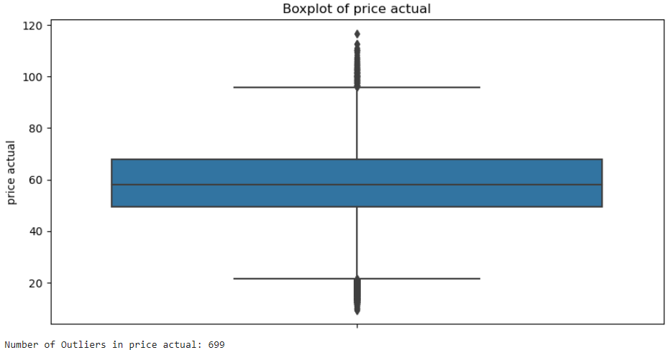
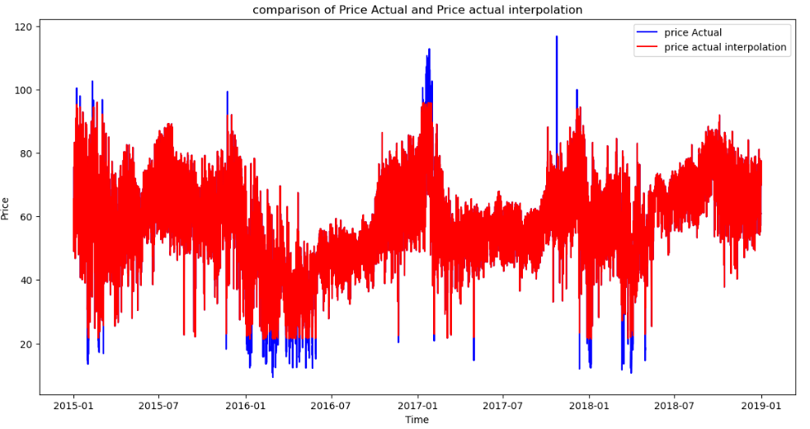
Feature Engineering
Outlier Detection:
Used IQR method: Q1, Q3, and IQR (Q3 - Q1).
Defined bounds: Q1 - 1.5 * IQR and Q3 + 1.5 * IQR.
Found 699 outliers in 'price actual'.
Outlier Handling:
Replaced outliers with NaN values.
Used interpolation to fill NaN values.
Creation of new Feature which help to improve the models accuracy:
is_weekday:
Extracted day of the week.
Created column to indicate weekdays (1) and weekends (0).
Peak/Off-Peak:
Extracted hour from 'time' column.
Calculated average electricity demand for each hour.
Created column to indicate peak (1) and off-peak (0) hours.
Month Columns:
Created separate columns for each month.
Additional Date Features:
Extracted month, day, weekday, and weekend indicators from 'time' column.

Slide 7
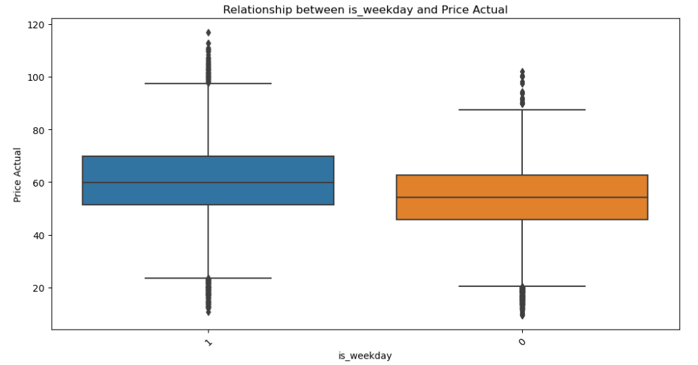
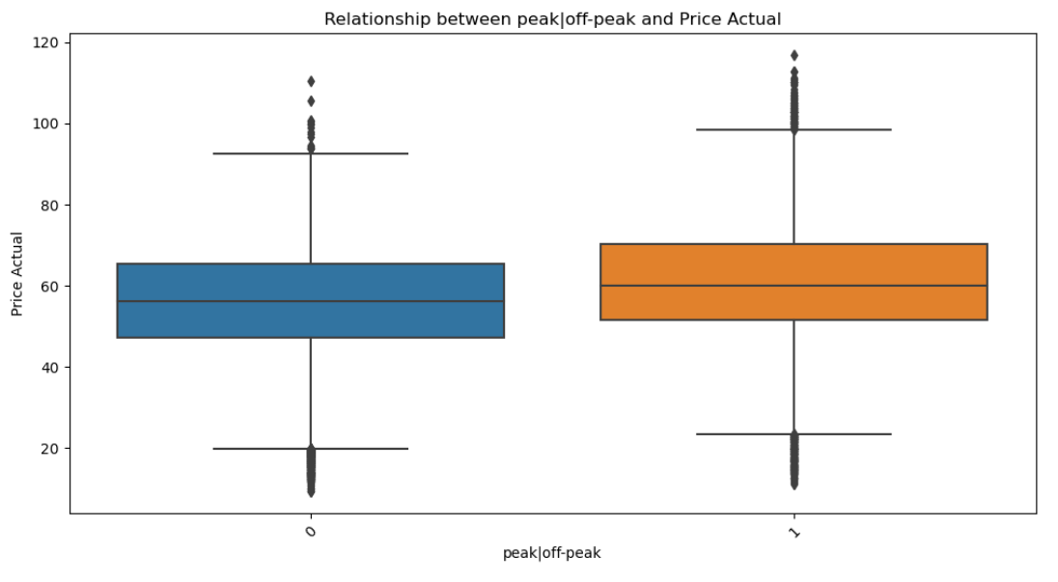
Data Visualization
(Weekday)
(Weekend)
Price difference: Price is more on weekdays than weekends.
Price spread: Prices vary more on weekdays (larger IQR).
(Off_peak)
(peak)
Peak prices: Higher than off-peak prices.
Price variation: Greater during peak times.

Slide 8
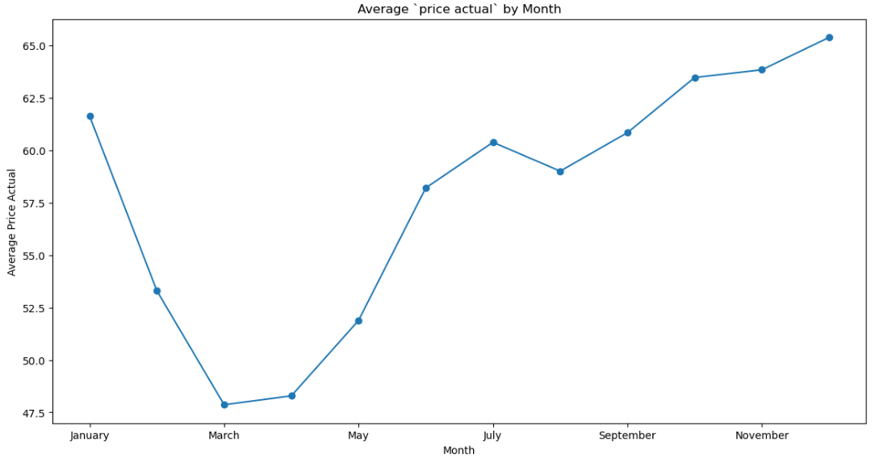
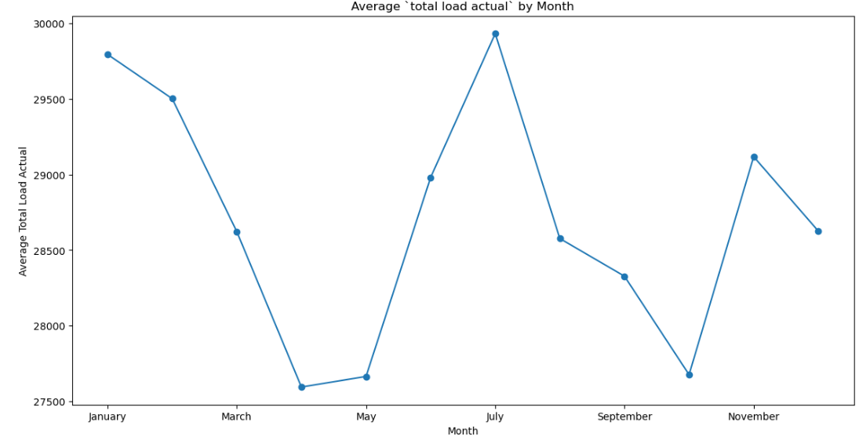
Data Visualization Cont…
Average price fluctuates throughout the year, with a peak in December and a low point in March.
The price increases from January to December, with a slight dip in June and August.
The price is lowest in March and April.
The price is highest in December, at around 65.
Average total load actual fluctuates throughout the year, with a peak in July and a low point in April.
The load increases from May to July, then decreases from July to October, with a slight increase in November.
The load is lowest in April, at around 27600, and highest in July, at around 29750.

Slide 9
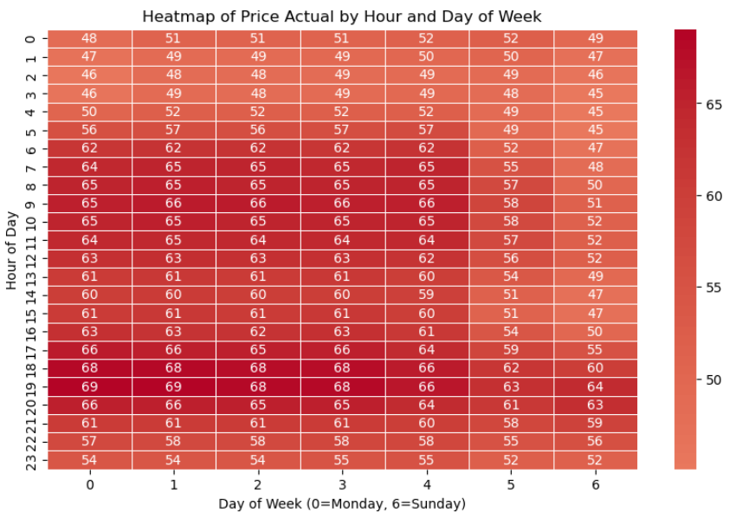
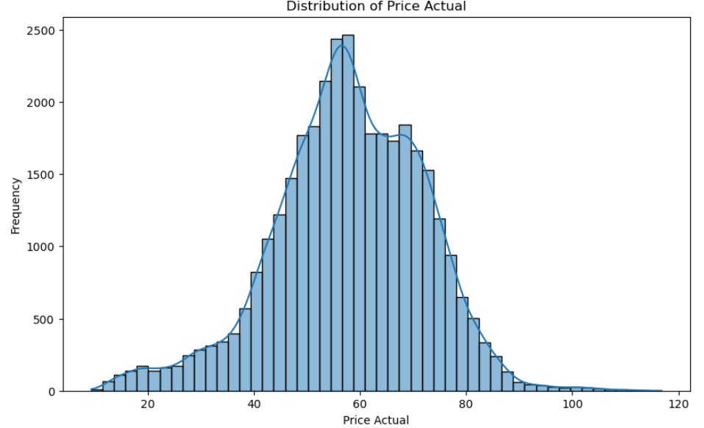
Data Visualization Cont…
Normal distribution: Most prices are between 40 and 70.
Price peaks: Prices are generally highest from Thursday to Sunday, and during evening hours (around 18:00 - 22:00).
Price troughs: Prices are lowest on Mondays and Tuesdays, and during early morning hours (around 02:00 - 06:00).
Consistent pattern: The price pattern repeats across weeks with minor variations.
Price range: Prices fluctuate between 45 and 69.

Slide 10
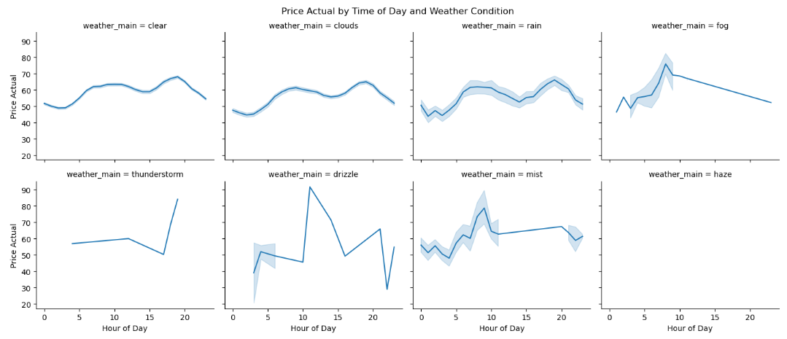
Data Visualization Cont…
Overall Trend
Price Fluctuations: The price fluctuates throughout the day for all weather conditions.
Weather-Specific Trends
Haze: Highest prices are observed during haze, particularly in the evening hours.
Thunderstorm: Prices tend to be lower during thunderstorms compared to other weather conditions.
Clear, Clouds, Rain, Fog, Drizzle, Mist: Prices for these weather conditions show similar patterns with fluctuations throughout the day but without a strong correlation to price levels.

Slide 11
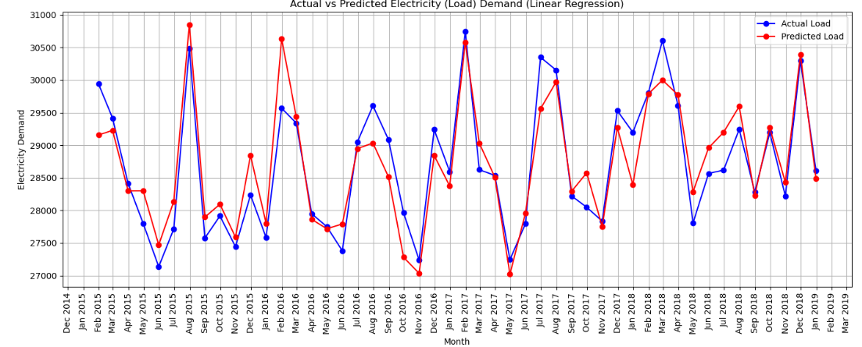
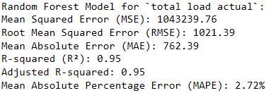
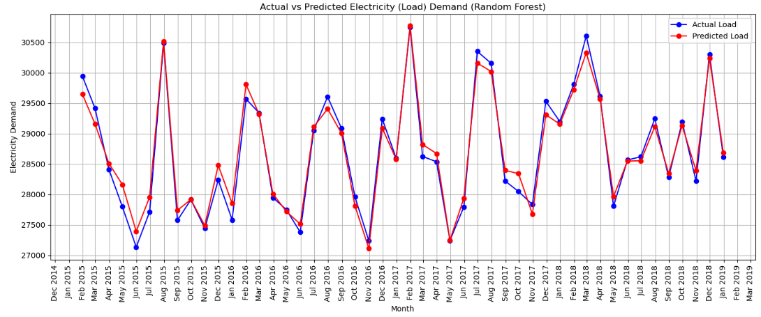
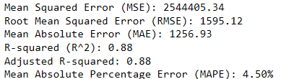
Model Implementation
Random Forest Model for Load Prediction
Linear Regression Model for Load prediction

Slide 12
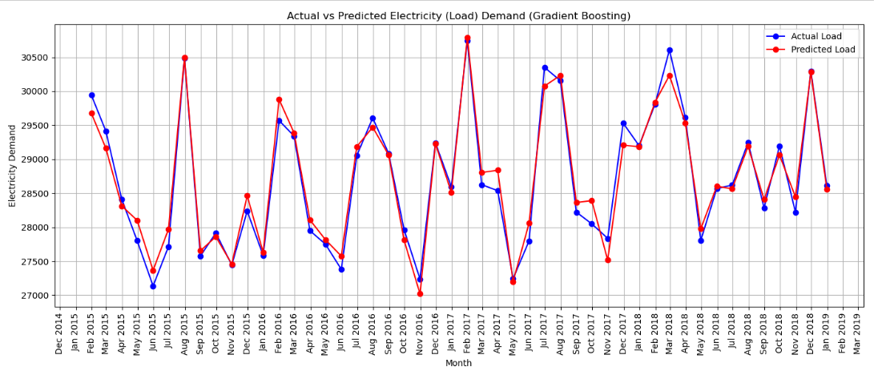
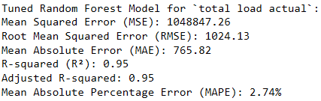
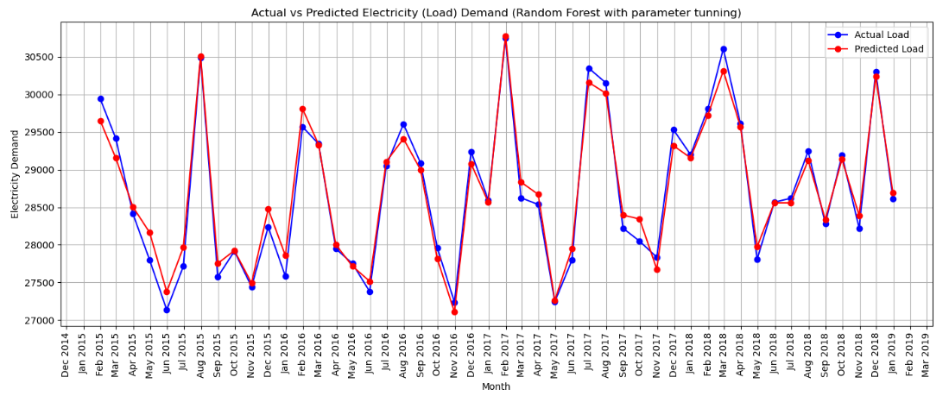
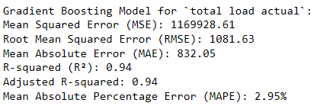
Model Implementation Cont…
Random Forest Model for Load Prediction with Parameter Tuning
Gradient Boosting Model for Load Prediction

Slide 13
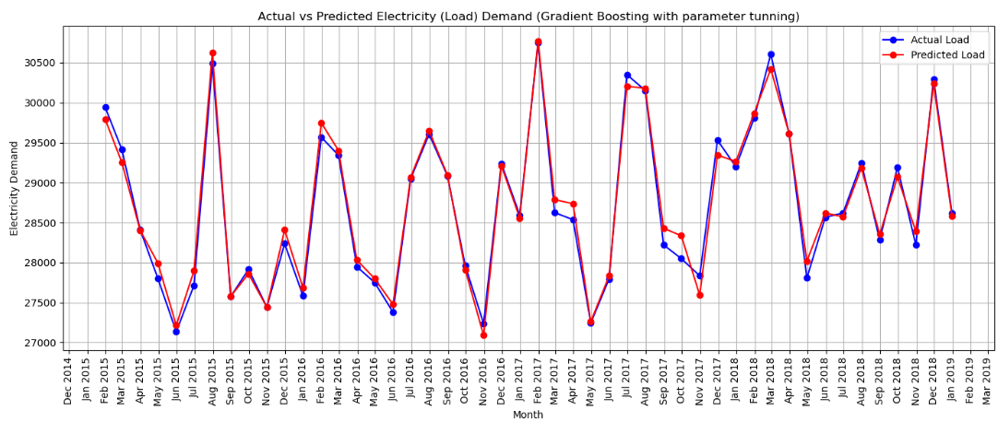
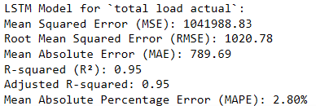
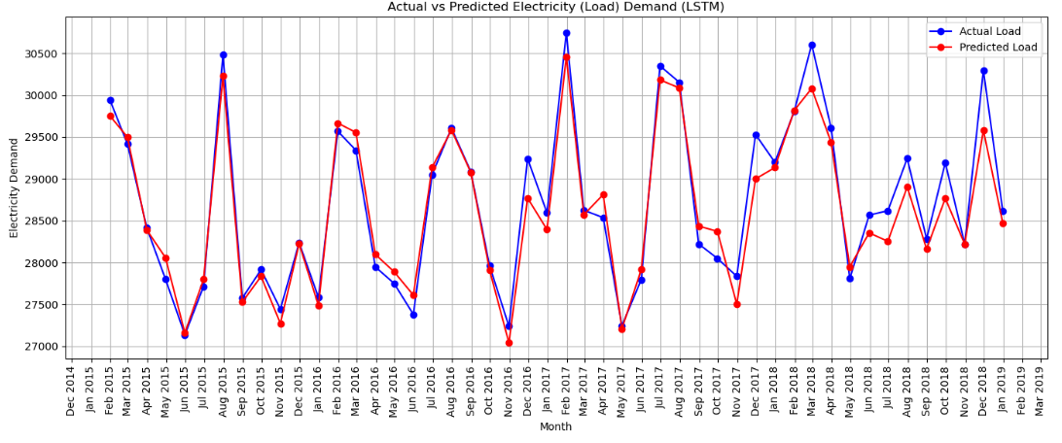
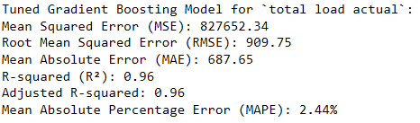
Model Implementation Cont…
LSTM Model for Load Prediction
Gradient Boosting Model for Load Prediction with Parameter tuning

Slide 14
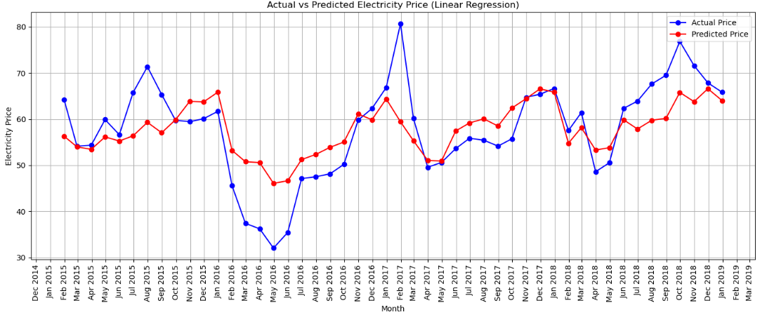
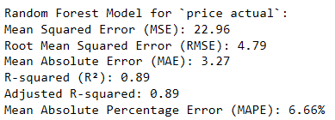
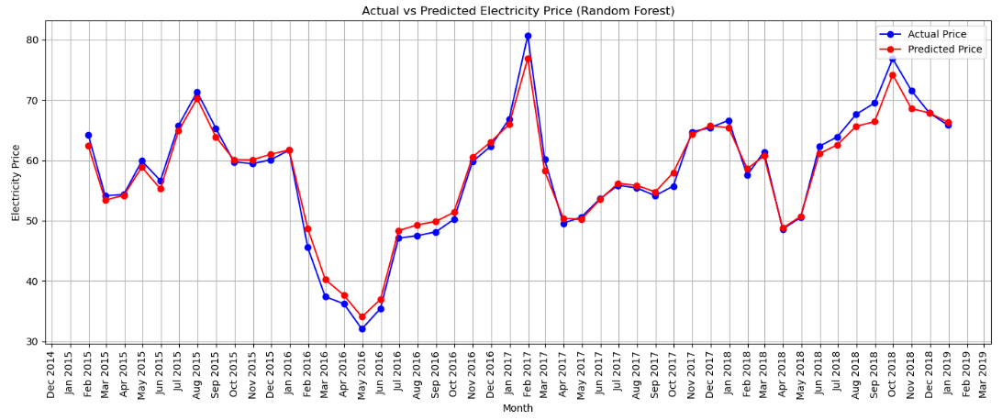
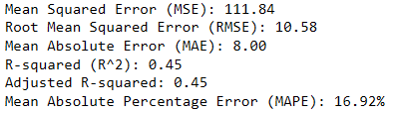
Model Implementation Cont…
Random Forest Model for Price Prediction
Linear Regression Model for Price Prediction

Slide 15
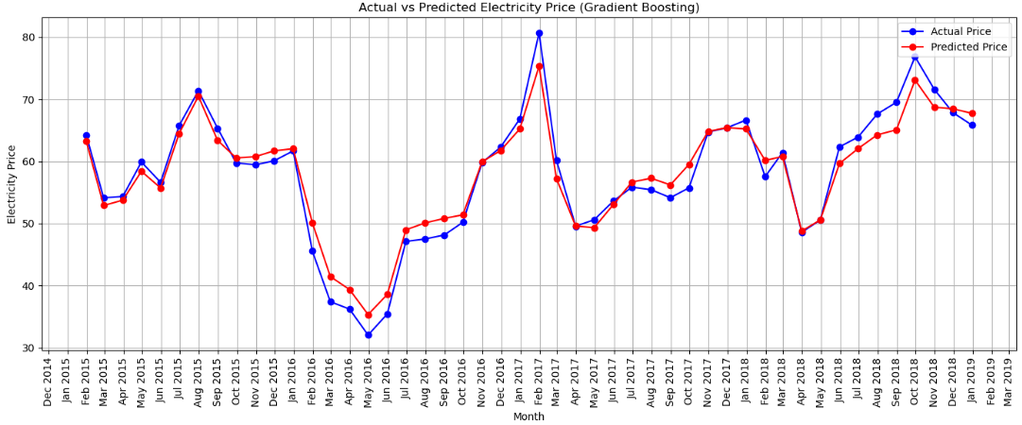
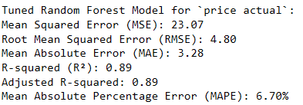
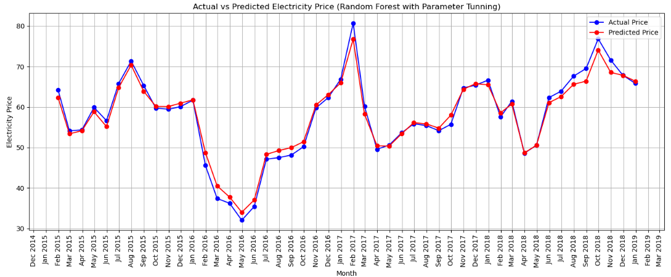
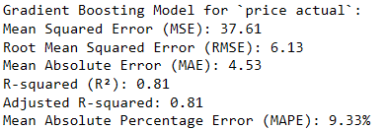
Model Implementation Cont…
Random Forest Model Price Prediction with Parameter Tuning
Gradient Boosting Model for Price Prediction

Slide 16
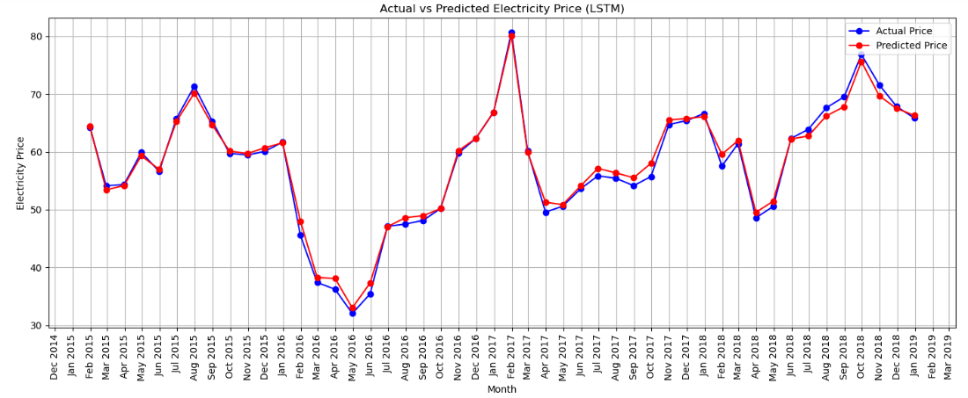
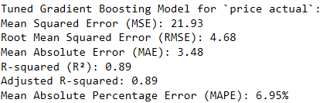

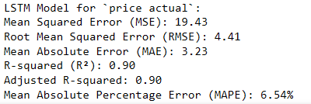
Model Implementation Cont…
Gradient Boosting Model for Price Prediction with Parameter tuning
LSTM Model for Price Prediction

Slide 17
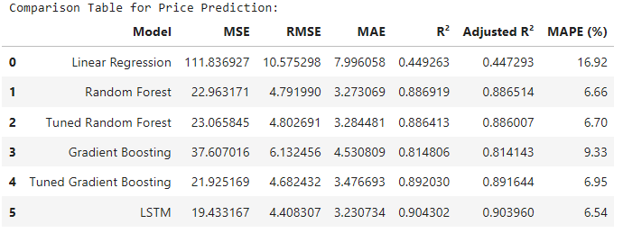
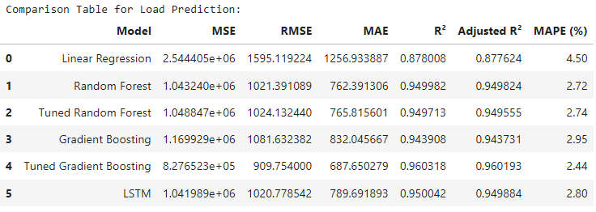
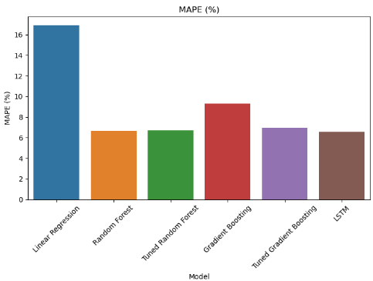
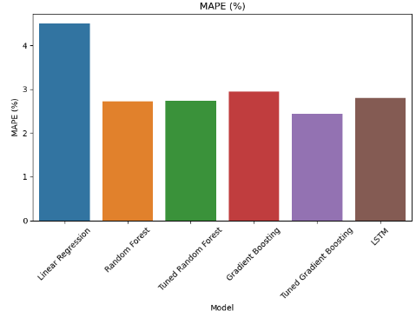
Model Comparison
MAPE value Comparison for Price Prediction Models
MAPE value Comparison for Load Prediction Models

Slide 18
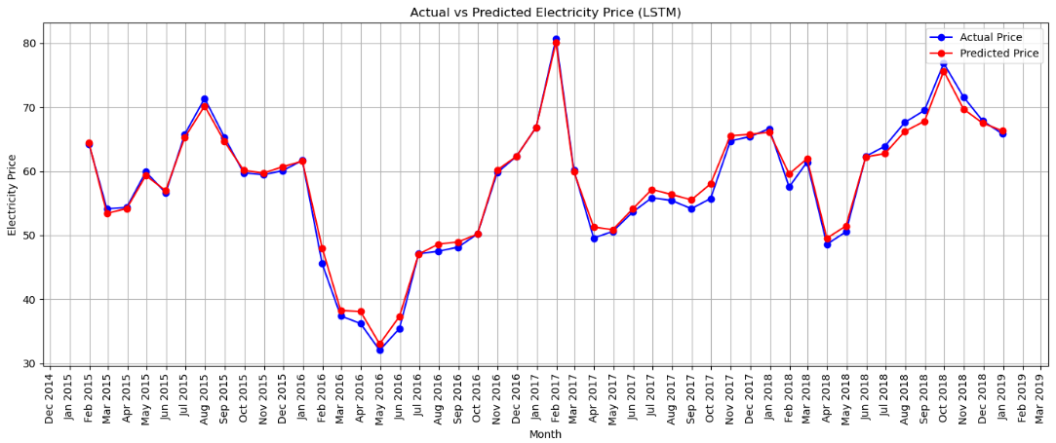
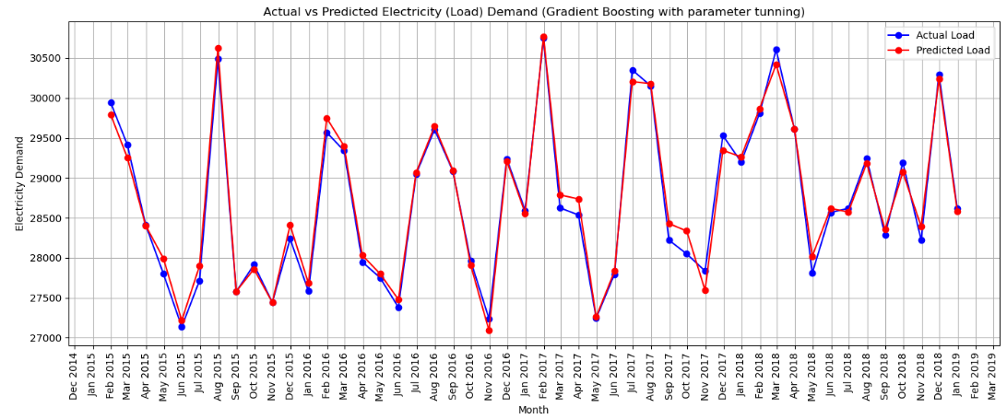
Model Selection
For Price Prediction Model
Selected Model: LSTM
The LSTM model has the lowest MSE (19.43), RMSE (4.41), and MAPE (6.54%), and the highest R² (0.9043) and Adjusted R² (0.9039), making it the most accurate model for price prediction.
For Load Prediction Model
Selected Model: Tuned Gradient Boosting
The Tuned Gradient Boosting model has the lowest MSE (827652.3), RMSE (909.75), and MAPE (2.44%), and the highest R² (0.9603) and Adjusted R² (0.9602), making it the most accurate model for load prediction.

Slide 19
Conclusion
Accurate Forecasting:
Developed effective models for predicting electricity demand and prices, supporting better energy management.
Model Highlights:
Price Prediction: LSTM model achieved top performance with lowest errors and highest accuracy (R² = 0.9043).
Load Prediction: Tuned Gradient Boosting model performed best with minimal errors and highest accuracy (R² = 0.9603).
Insights:
Significant variations in electricity prices and demand based on weekdays, time, and weather conditions.
Identification of peak periods aids in strategic energy resource management.
Future Directions:
Enhance models with additional features and explore new techniques.
Regular updates to models to keep up with evolving energy consumption patterns.
Impact:
Better decision-making for utilities and grid operators.
Improved efficiency in energy distribution, resulting in cost savings and reliable supply.

